Slide 1
Sampling Distributions
Probability Calculations of Sample Proportions
Probability Calculations of Sample Means
Central Limit Theorem (More Advanced… But Important)

Slide 2
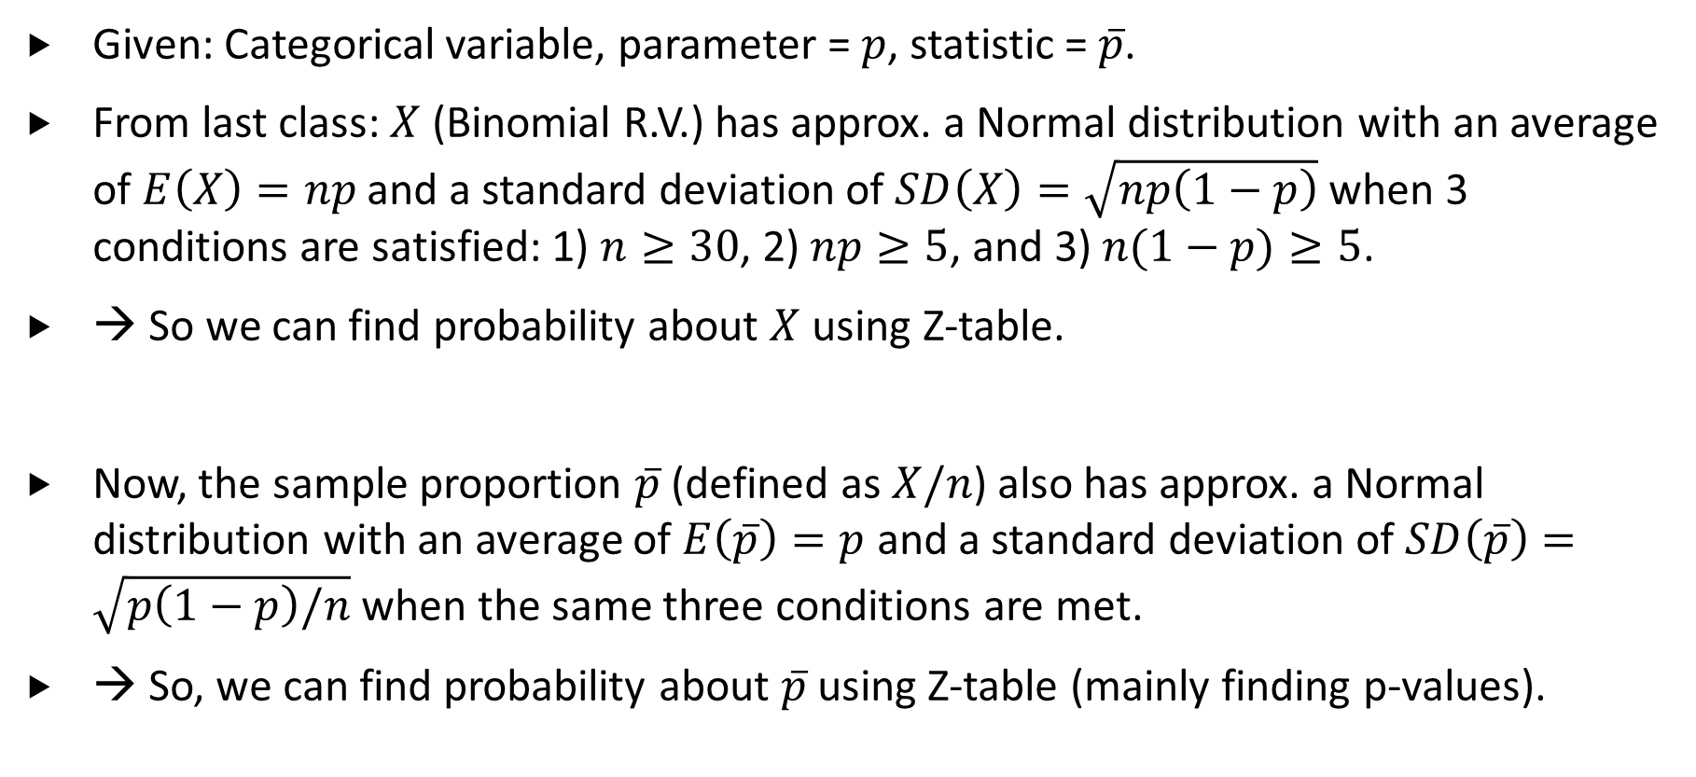
Sampling Distributions of $\overline{p}$ (M09.4-7)
Given: Categorical variable, parameter = $p$, statistic = $\overline{p}$.
From last class: $X$ (Binomial R.V.) has approx. a Normal distribution with an average of $E\left(X\right)=np$ and a standard deviation of $SD\left(X\right)=\sqrt{np\left(1−p\right)}$ when 3 conditions are satisfied: 1) $n≥30$, 2) $np≥5$, and 3) $n(1−p)≥5$.
→ So we can find probability about $X$ using Z-table.
Now, the sample proportion $\overline{p}$ (defined as $X/n$) also has approx. a Normal distribution with an average of $E\left(\overline{p}\right)=p$ and a standard deviation of $SD\left(\overline{p}\right)=\sqrt{p\left(1−p\right)/n}$ when the same three conditions are met.
→ So, we can find probability about $\overline{p}$ using Z-table (mainly finding p-values).

Slide 3
Example (1 of 2)
Example: Suppose 25% of Canadians would vote for Justin Trudeau in January 2024. In May 2024, 1000 randomly selected Canadians was asked if they would vote for Justin Trudeau. Only 225 of them replied with Yes. Find the probability that this value or smaller value would happen again.
Again, the focus is the statistic (or proportion) of the random sample of size 1000.
In other words, it has something to do with the sampling distributions!
a) Provide a description of the key statistic.
b) Identify the sampling distribution of the statistic. Note that checking conditions is part of the procedure.
Notes:
Subjects = Canadians (May 2024)
Variable = whether or not a Canadian would vote for Trudeau (Yes or No)
Type = Categorical variable
a) Define pbar as the proportion of the 1000 randomly selected Canadian who would vote for Trudeau in May 2024
b) Sampling distribution of pbar
1. Shape of pbar = approx. Normal
2. E(pbar) = p = 0.25
3. SD(pbar) = sqrt[ 0.25*(1-0.25)/1000 ] = 0.0137
Checking 3 conditions:
n = 1000, which is bigger than the requirement of 30,
np = 1000*0.25 = 250, which is bigger than the requirement of 5,
n(1-p) = 1000*0.75 = 750, which is bigger than the requirement of 5.
Since all 3 conditions are met, the approximation (above) is good enough.

Slide 4
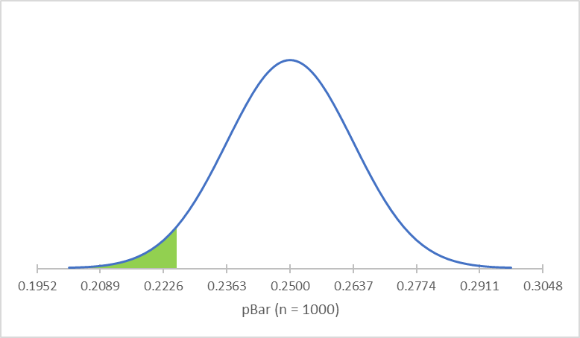
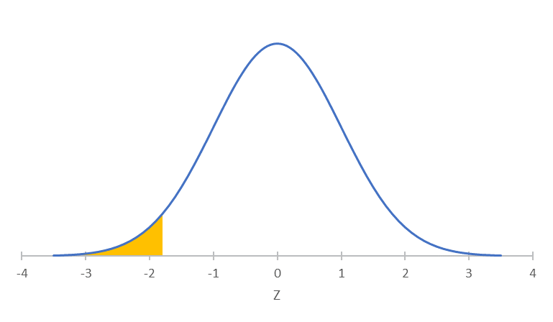
Example (2 of 2)
Example: … Only 225 of them replied with Yes. Find the probability that this value or smaller value would happen again.
Step 1: Z = (0.225 – 0.25)/0.0137 = -1.824 or -1.82
Step 2: CA = 0.0344
Answer: About 3.44% of all random samples of 1000 Canadians that have 225 or fewer Canadians voting for Trudeau.

Slide 5
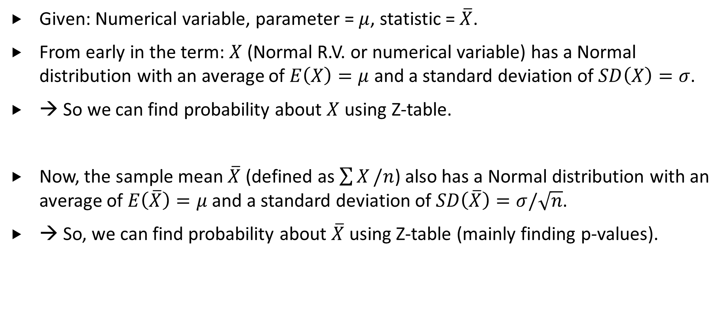
Sampling Distributions of $\overline{X}$ (M09.1-3)
Given: Numerical variable, parameter = $μ$, statistic = $\overline{X}$.
From early in the term: $X$ (Normal R.V. or numerical variable) has a Normal distribution with an average of $E\left(X\right)=μ$ and a standard deviation of $SD\left(X\right)=σ$.
→ So we can find probability about $X$ using Z-table.
Now, the sample mean $\overline{X}$ (defined as $\sum{X}/n$) also has a Normal distribution with an average of $E\left(\overline{X}\right)=μ$ and a standard deviation of $SD\left(\overline{X}\right)=σ/\sqrt{n}$.
→ So, we can find probability about $\overline{X}$ using Z-table (mainly finding p-values).

Slide 6
Example (1 of 2)
Example: Suppose the score of a large class follows a Normal distribution with an average of 72% and a standard deviation of 8%. A random sample of 25 students was drawn. Find the probability that the average score of a random sample of 25 students will be 75% or above.
Here, the focus is the statistic (or average) of the random sample of size 25.
In other words, it has something to do with the sampling distributions!
a) Provide a description of the key statistic.
b) Identify the sampling distribution of the statistic.
Notes:
Subjects = students
Variable =score (in %)
Type = Numerical variable
a) Define xbar as the average score of 25 randomly selected students
b) Sampling distribution of xbar
1. Shape of xbar = Normal (because X is Normal)
2. E(xbar) = mu = 72
3. SD(xbar) = 8/sqrt(25) = 1.60

Slide 7
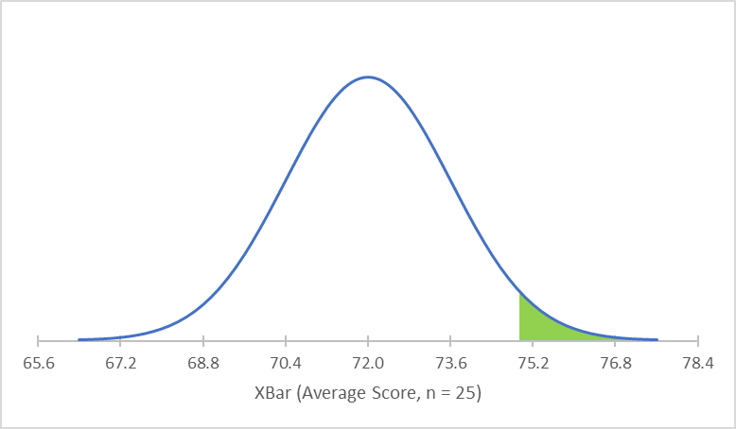
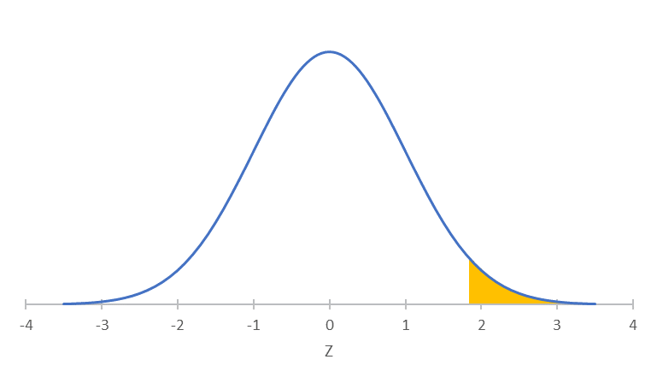
Example (2 of 2)
Example: … Find the probability that the average score of a random sample of 25 students will be 75% or above.
Step 1: Z = (75 – 72)/1.60 = +1.875 or +1.88 (after rounding)
Step 2:CA = 0.9699
Answer: About 3.01% of all random samples of 25 students will get an average of 75% or above.

Slide 8
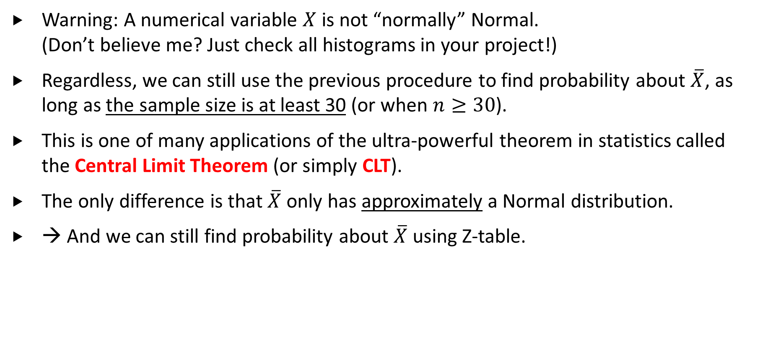
Sampling Distributions of $\overline{X}$ - Part 2
Warning: A numerical variable $X$ is not “normally” Normal. (Don’t believe me? Just check all histograms in your project!)
Regardless, we can still use the previous procedure to find probability about $\overline{X}$, as long as the sample size is at least 30 (or when $n≥30$).
This is one of many applications of the ultra-powerful theorem in statistics called the Central Limit Theorem (or simply CLT).
The only difference is that $\overline{X}$ only has approximately a Normal distribution.
→ And we can still find probability about $\overline{X}$ using Z-table.

Slide 9
Example
Example: Suppose the daily social media time of teenagers has a severely right-skewed distribution with an average of 8 hours and a standard deviation of 6 hours. A random sample of 36 students was drawn.
a) Provide a description of the key statistic.
b) Identify the sampling distribution of the statistic. Note that checking conditions is part of the procedure.
c) Find the probability that the average of the sample will be longer than 10 hours per day.
Notes:
Subjects = teenagers
Variable =daily social media time (in hour)
Type = Numerical variable
a) Define xbar as the average daily social media time of 36 randomly selected teenagers
b) Sampling distribution of xbar
1. Shape of xbar = approx. Normal (see below for verification)
2. E(xbar) = mu = 8
3. SD(xbar) = 6/sqrt(36) = 1
Condition Checking:
Note that the numerical variable of interest (daily social media time) does not have a Normal distribution.
n = 36, which is bigger than the requirement of 30.
Since the condition is satisfied, the approx. (above) is good enough.
In other words, xbar will have approximately a Normal distribution.
c) Z = (10 – 8)/1 = +2.00
From Z-table, CA = 0.9772
-> Answer = 0.0228

Slide 10

Any Questions?

